Slide 1
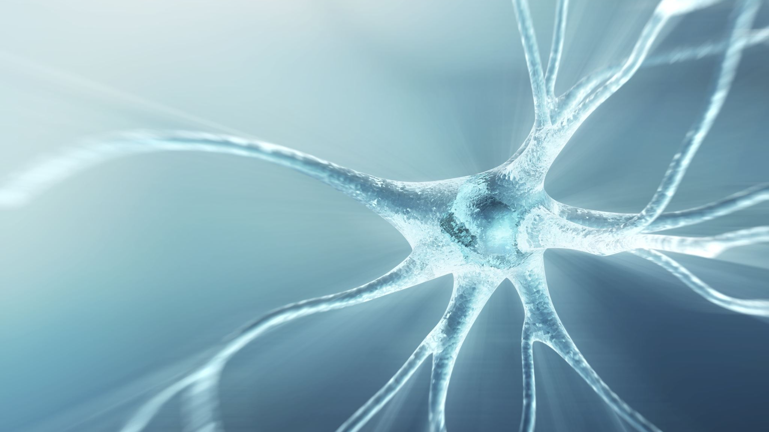
Physiology of audition

Slide 2
The problem of perception
“The problem of perception is initially a problem of taxonomy in which the individual animal must “classify” the things of its world (…) The internal taxonomy of perception is adaptive but is not necessarily veridical in the sense that it is concordant with the descriptions of physics”
Edelman, Neural Darwinism, p. 26

Slide 3
Physical properties / Sensations (Perceptual properties) / Musical properties
Physical
Frequency (periodicity)
Amplitude
Perceptual
Pitch
Loudness
Musical
Melodies
Dynamics
Waveform
Timbre
Voices, instruments, texture, chords
Duration
Length
Figures, Rhythm

Slide 4
Stages in “perception”
Transduction (Cochlea)
From pressure changes to trains of spikes
Low-level detection
(features)
Parallel complementary codings, “sensations”
Scene Analysis (objects)
Integration of information
Memory, anticipation, emotion, goals…

Slide 5
Perception versus Cognition
Perception
Pressure converted to electro-chemical patterns
Transduction and basic sensations (pitch, loudness, timbre, localization…)
Cognition
Electro-chemical patterns becoming meaningful and adaptive
Musicality, musical knowledge (tension, movement, emotion, preference….)
Bottom-up
Automatic
Encapsulated
Top-down
Consciousness-mediated
Distributed

Slide 6

Sensory systems
Interoceptors: keep the brain informed about the status of internal organs (stomach, heart, etc.)
Proprioceptors: … about the body position (equilibrium –vestibular system-, limb movements –kinesthetic system)
Exteroceptors: … about the external world (traditional 5 senses);
Stages followed by the information: Transduction / Transmission to the cortex / Integration with other senses and info’

Slide 7
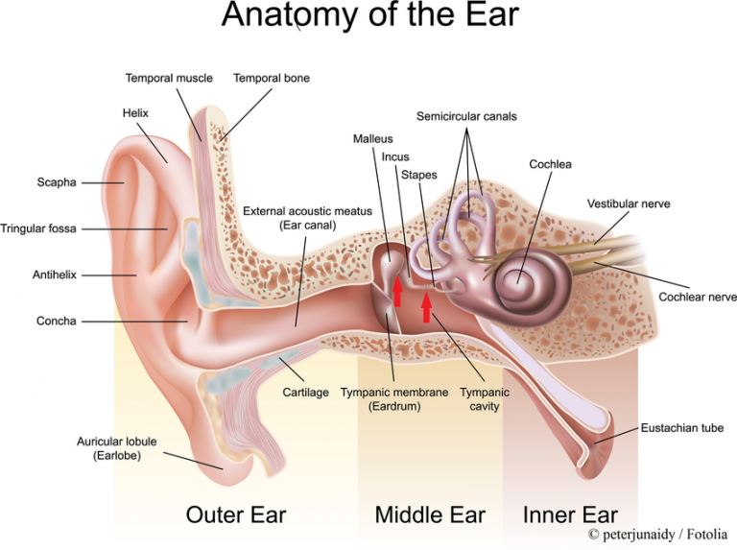
The Ear
https://www.purposegames.com/game/ear-labeling-quiz#

Slide 8
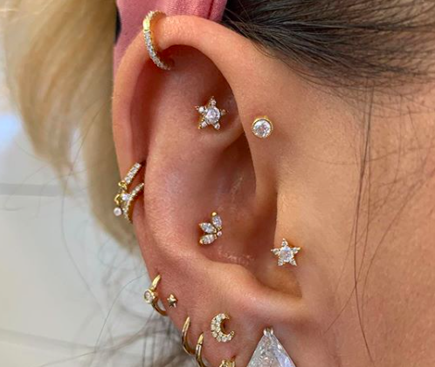
The Outer Ear
Sound collection (pinna macro-structure)
Localization (pinna micro-structure)
Protection (inner-canal, wax, inner hair)

Slide 9
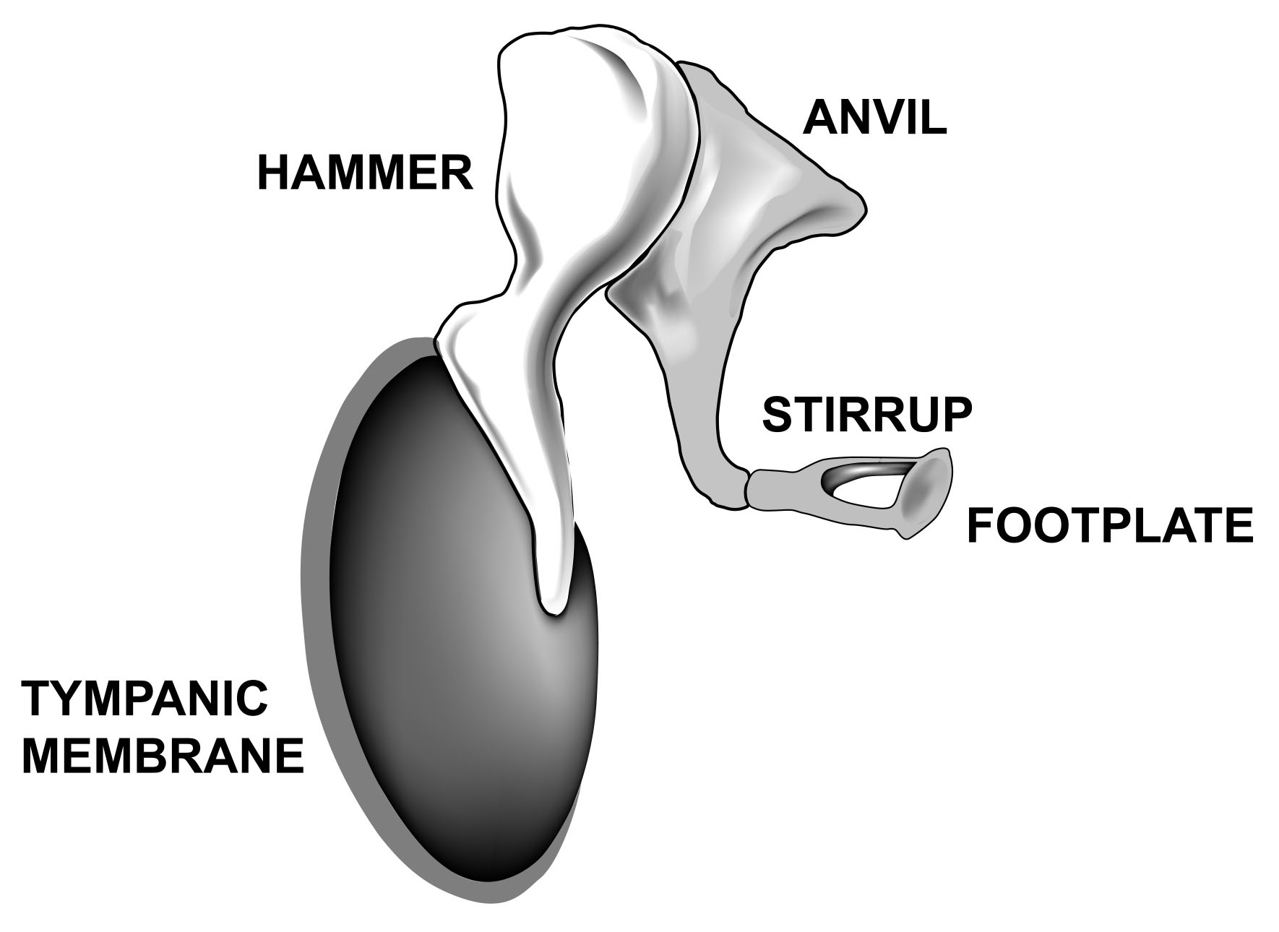
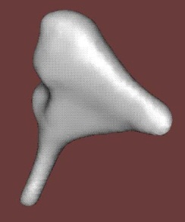
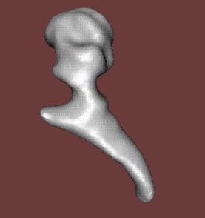
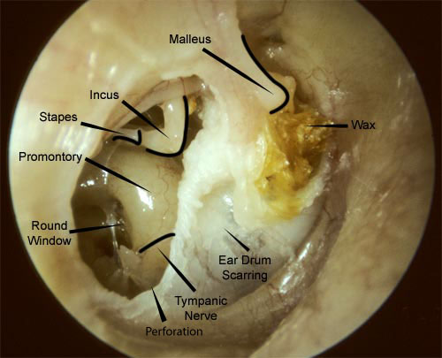
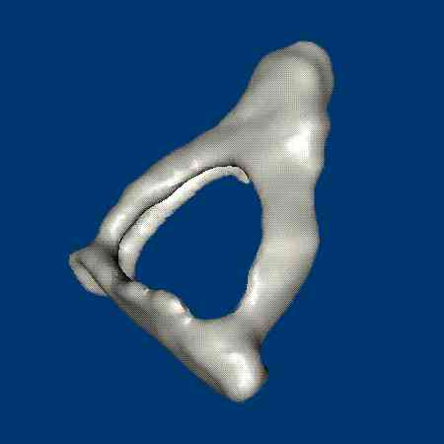
The Middle Ear
Amplification (ossicles – lever principle)
Pressure compensation (Eustachian tube)
Protection (acoustic reflex)

Slide 10
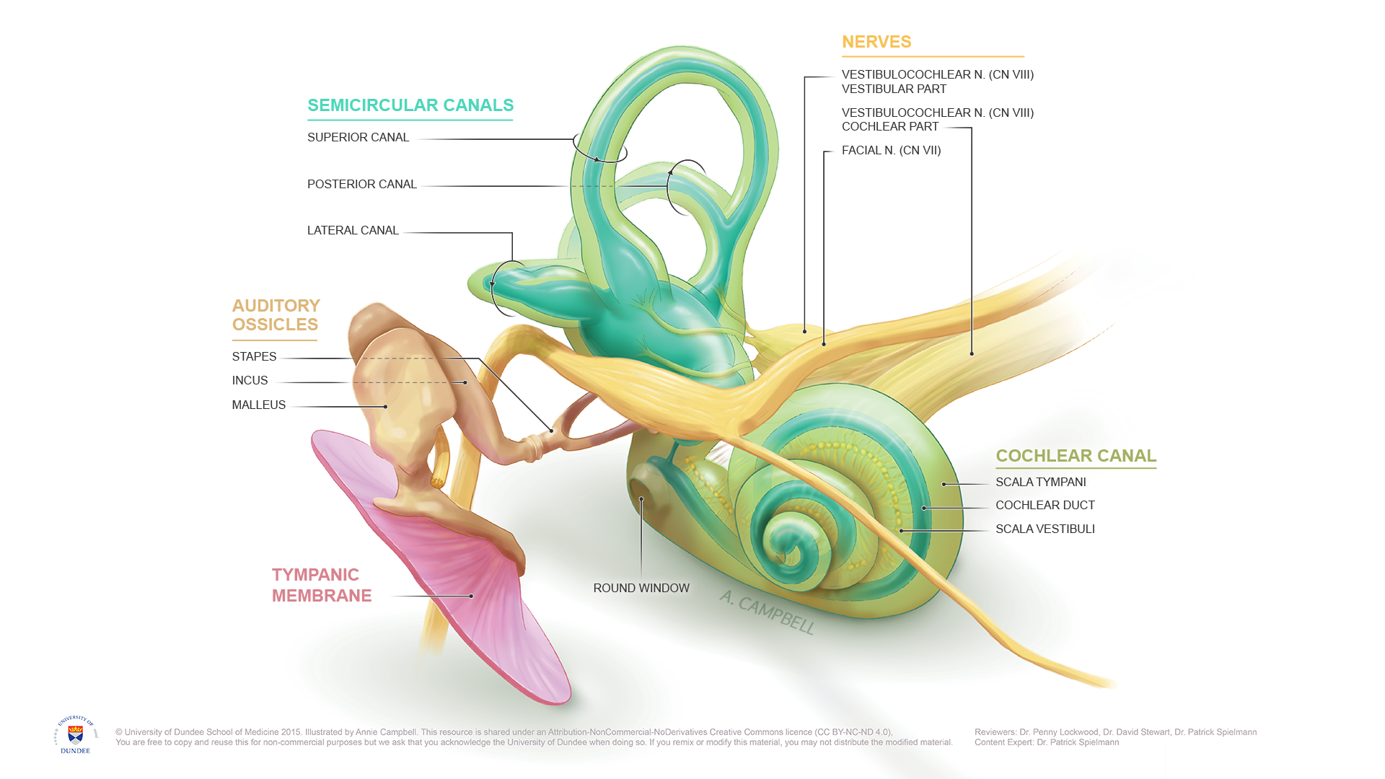
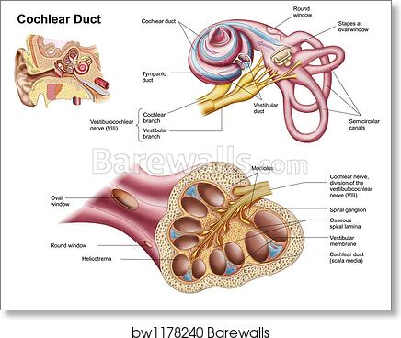
The Inner Ear
Transduction (cochlea)
Equilibrium (semicircular canals)

Slide 11
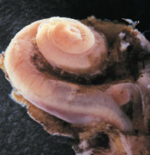
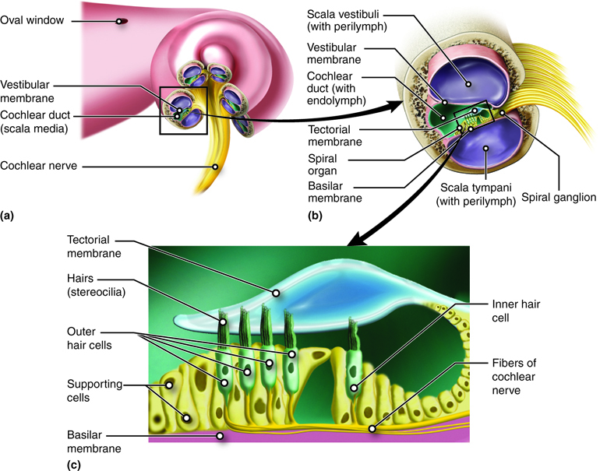
The Cochlea
Coiled tube (2.5 turns), 3 chambers
Basilar membrane, tectorial membrane
Organ of Corti, transduction
Outer and inner hair cells
Efferent and afferent neurons

Slide 12
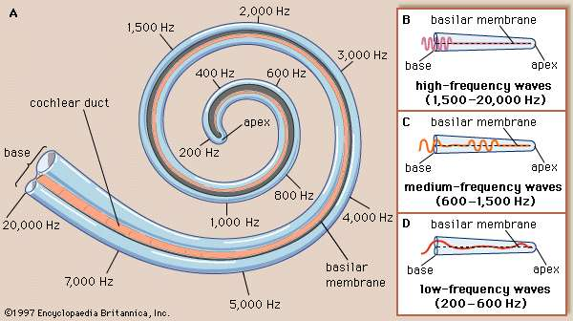
Travelling waves in the cochlea
Maximum vertical displacement of BM depending on sound frequency

Slide 13
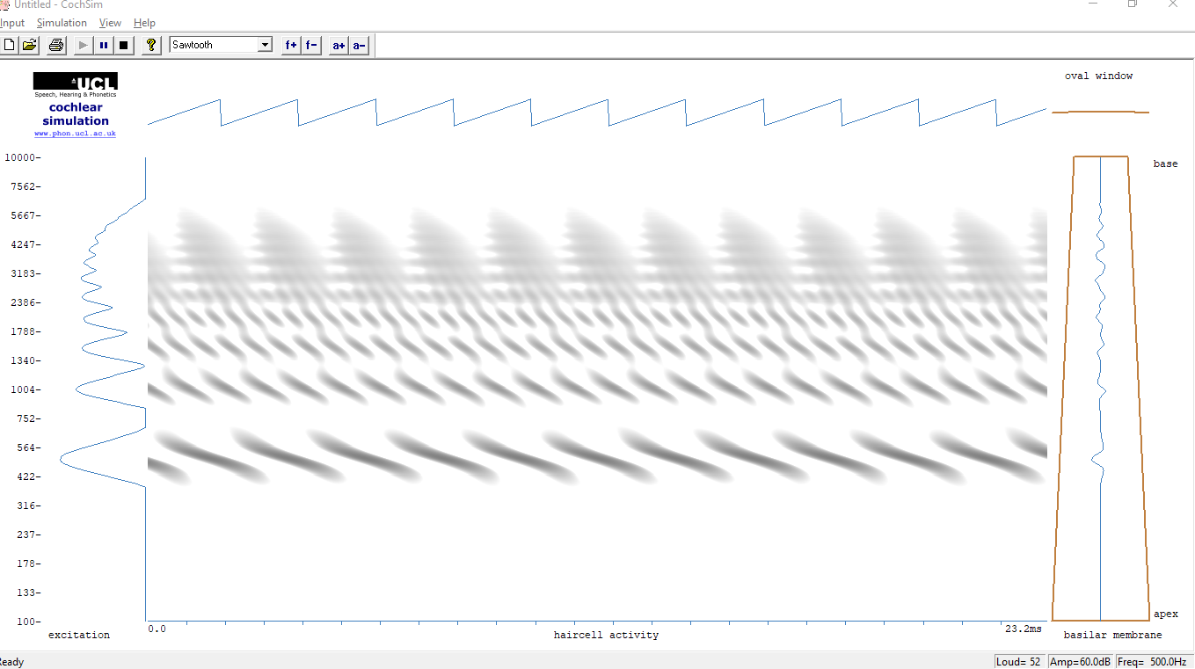
Cochsim

Slide 14
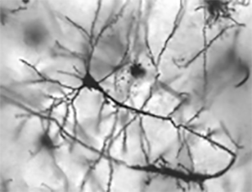

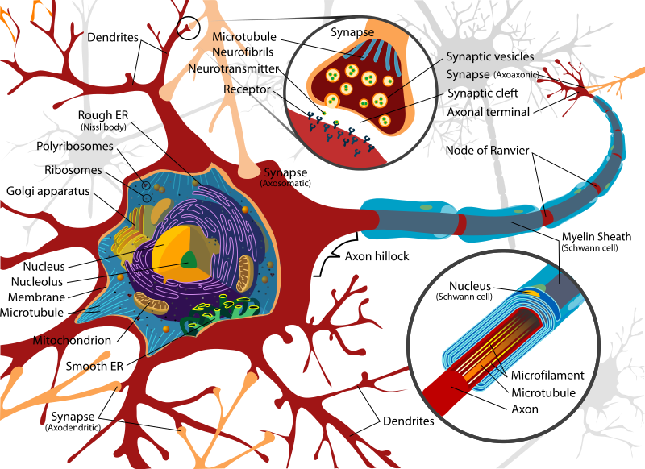
Neurons
Spontaeous stochastic activity
Binary devices (on: +50mV / off: -60mV)
Electro-chemical transmission
Speed limitation (<4000 spikes/s, <<120m/s)
Refractary period

Slide 15
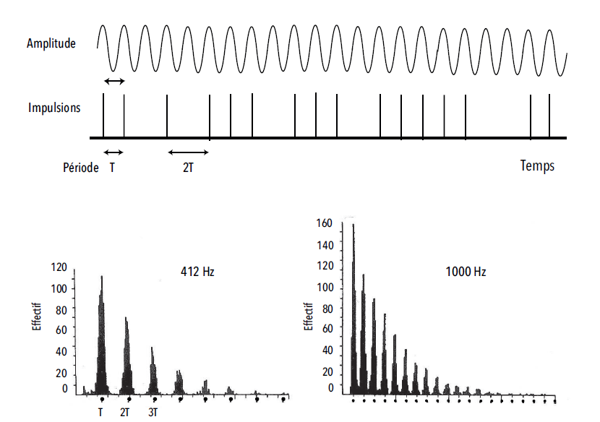
Coding of acoustic information
Phase-locking
2 codes: rate & place
Statistical behaviour of neuron ensembles

Slide 16
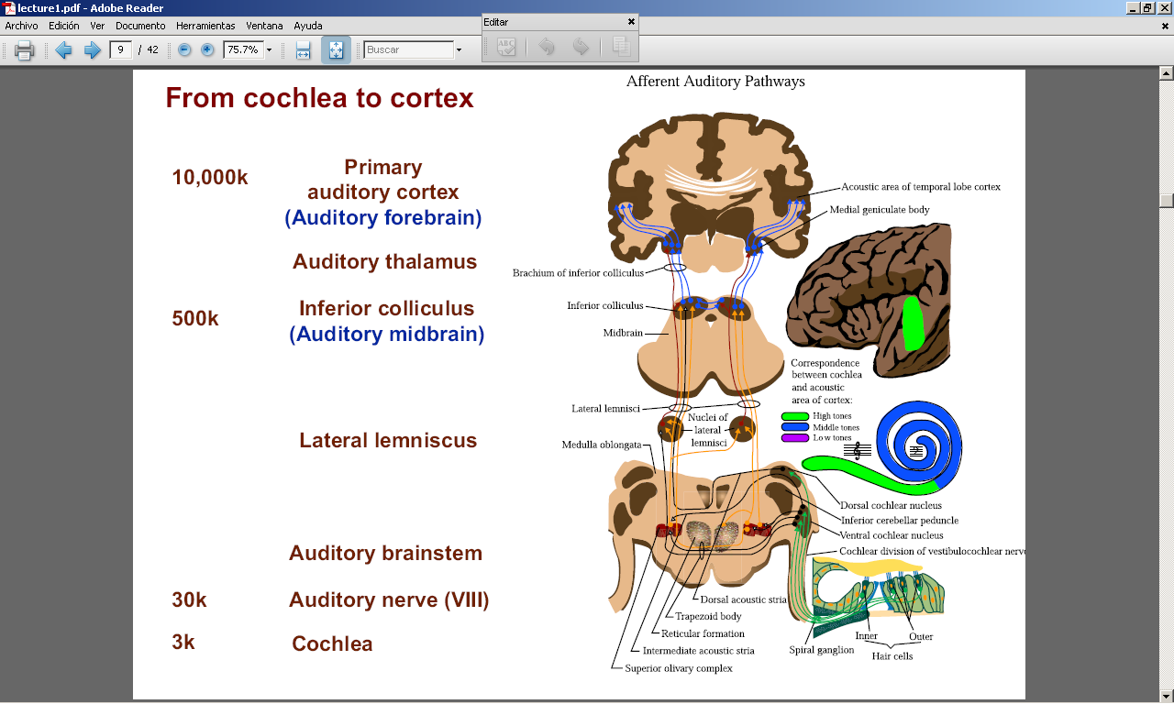
Auditory pathways
Cross-lateralization
Rough analyses (localization, loudness, noisiness, pitch…)
https://www.purposegames.com/game/auditory-pathways-quiz

Slide 17
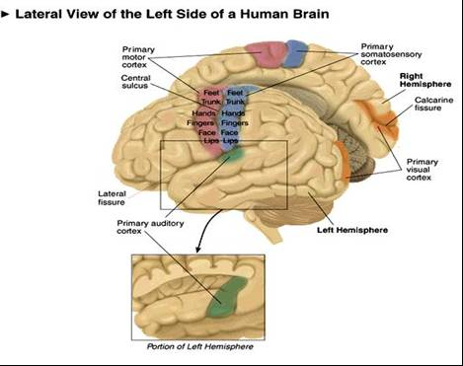
The brain
Hemispheres & lobes
Lateralization
Plasticity
https://www.purposegames.com/game/auditory-pathways-quiz

Slide 18
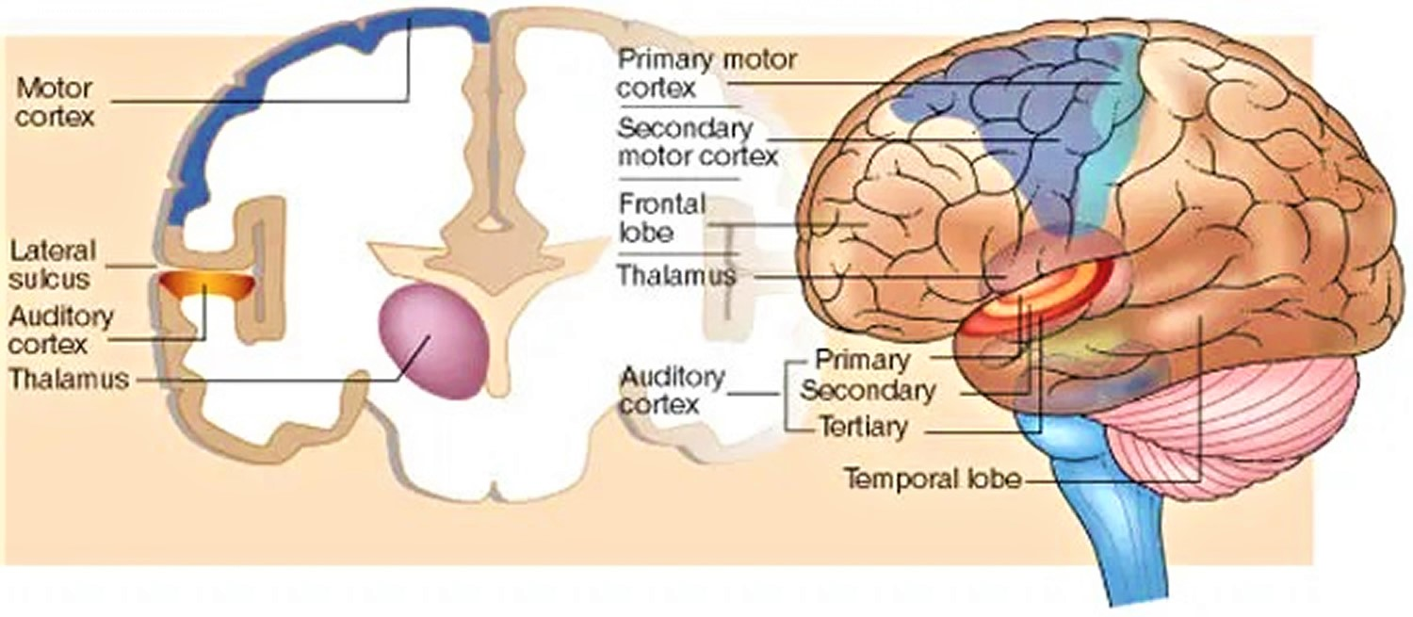
Auditory cortex
Temporal lobe
Primary, secondary, and associative regions
https://www.purposegames.com/game/auditory-pathways-quiz

Slide 19
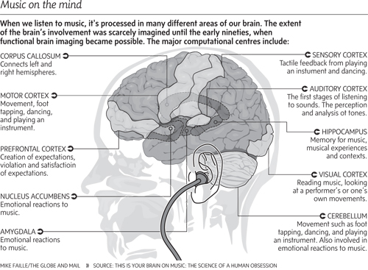
The musical brain

Slide 20
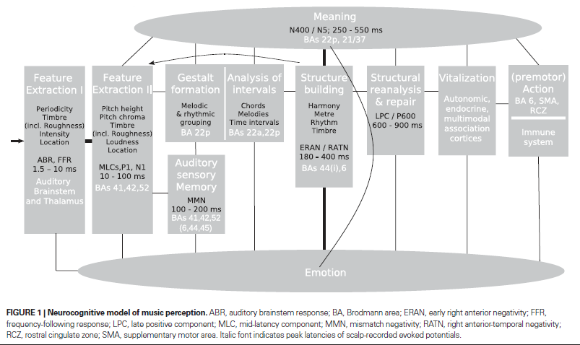
Timings in the musical brain (according to ERP studies)
Psychoacoustics
Music Cognition
Koelsch (2011). Toward a neural basis of music perception – a review and updated model
Trends in Cognitive Sciences

Slide 21
Music Cognition
Perceiving
Learning
Remembering
Producing
Performing

